Slide 1
Building an Analytic Community
Liz Matthews
Head of Community & Education

Slide 2
About Mango Solutions
Data Science
Training
Consulting
App Dev
Data Engineering
Analytic Infrastructure
DevOps for Data
Modernisation
Data Products
App Dev
Validation
Testing
Established in 2002
>80 people
Full Certified RStudio Partner
Currently over 70% of our work uses R

Slide 3
About Me
Head of Community & Education
Joined Mango in March 2010
Run the LondonR, ManchesterR, BaselR and Bristol Data Scientists User Groups
Created the EARL Conference in 2014

Slide 4

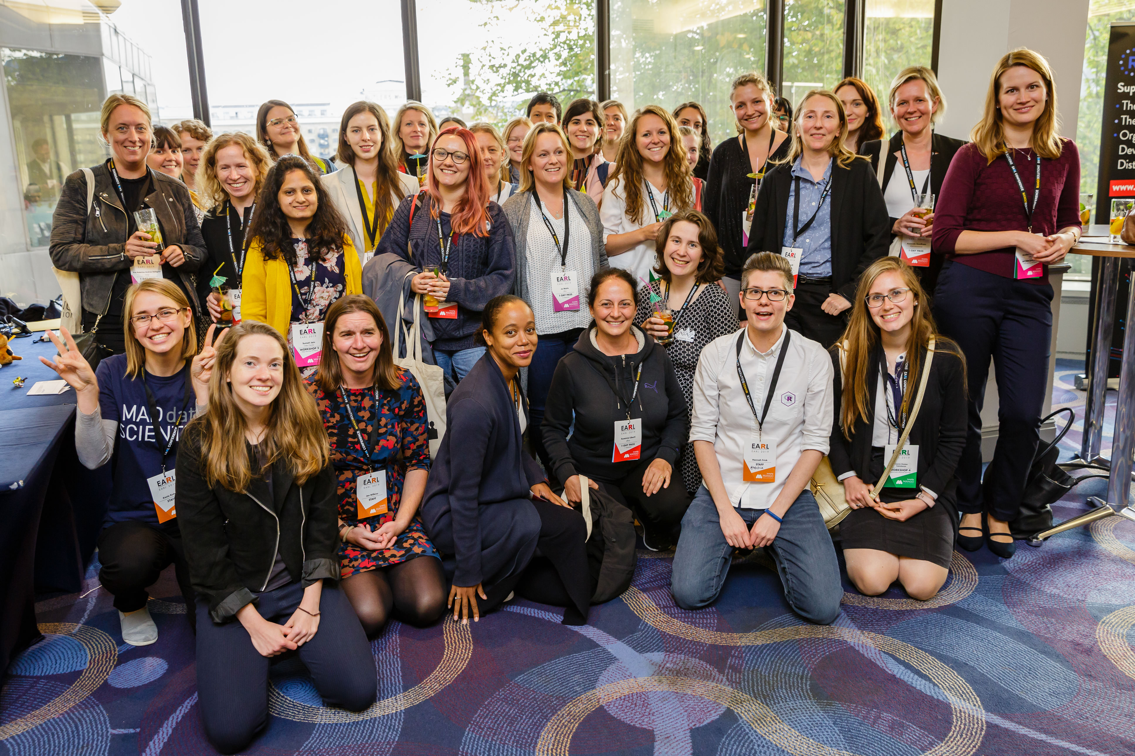

Why Build a Community?
If you want to go quickly, go alone. If you want to go far, go together
African Proverb

Slide 5


Benefits of an Analytic Community
Engender value and belonging
<copy>
Connect silo-ed teams or individuals
Share knowledge and upskill
Share Expertise
<copy>
<copy>
Improve staff satisfaction and retention
Drive conversations around best practices/ standardizing processes
Create efficiencies

Slide 6
The Barriers
Organisations don’t understand what analytics skills they have
Analytic Skills are spread across the Organisation
The Organisation may have aspirations for analytics but individuals are disconnected
“Analytics has grown over time, often resulting in pockets of expertise across the business that can be disconnected from each other. Creating a sense of Community is first.”
Arlene Hewitson-Townley, Senior Manager, Analytics Community, Lloyds Banking Group
“We’re sitting on an enormous data asset and we’ve made inroads into the hard yards to make this data available in a way that makes it useful and consumable by all, rather than in the vertical siloes of our business.”
Helen Hunter, Chief Data and Analytics Officer, Sainsbury’s

Slide 7
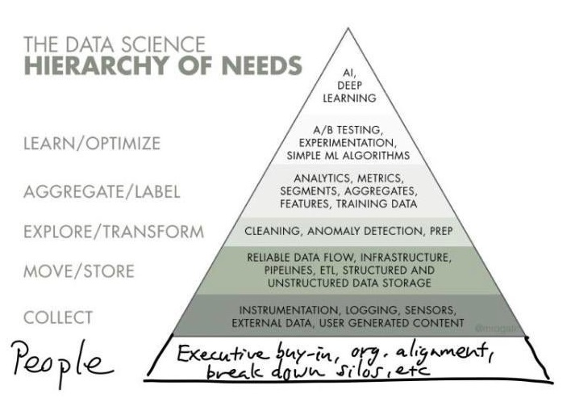

Slide 8
Culture > Question beats Abstraction beats Algorithm beats Technology

Slide 9
Building an Analytic Community

Slide 10

Identify your Champions

Slide 11


Connect your Members

Slide 12


Inspire
You don’t inspire people by revealing your super powers
You inspire people by helping them reveal their own super powers

Slide 13
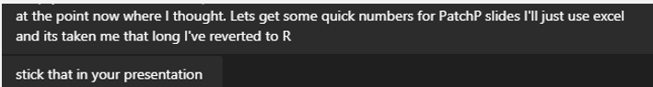
How I got my boss addicted to R

Slide 14
Enthusiasm is Contagious…
I’m only at the start of my R journey, but I can already see the benefits of using it daily to support all aspects of my reignited analytical life, so I’m excited about what the future holds! It’s a positive sign and a step in the right direction when these software programmes are being talked about by our NHS leaders, but what I am most enthused about is the will and the want to work collaboratively and share learning on all things R without judgement across organisations both internal and external to the NHS. So, I’m fully signed up to spreading the R message by being an active participant in any local R Working groups, presenting on R possibilities at different networking events whilst working as hard as I can on improving my own R skills. Watch this space, I may even take the leap and do some more blogs about my ‘R’ journey!
Vicki Cruze, Principal Analyst in the Performance Analysis Team at NHS England and NHS Improvement.

Slide 15
With an Analytics Community in place…
Align & connect the members of the Community
Leverage the Talent within the Community
Drive Conversations around best practice
Look at opportunities for collaboration and creating efficiencies

Slide 16




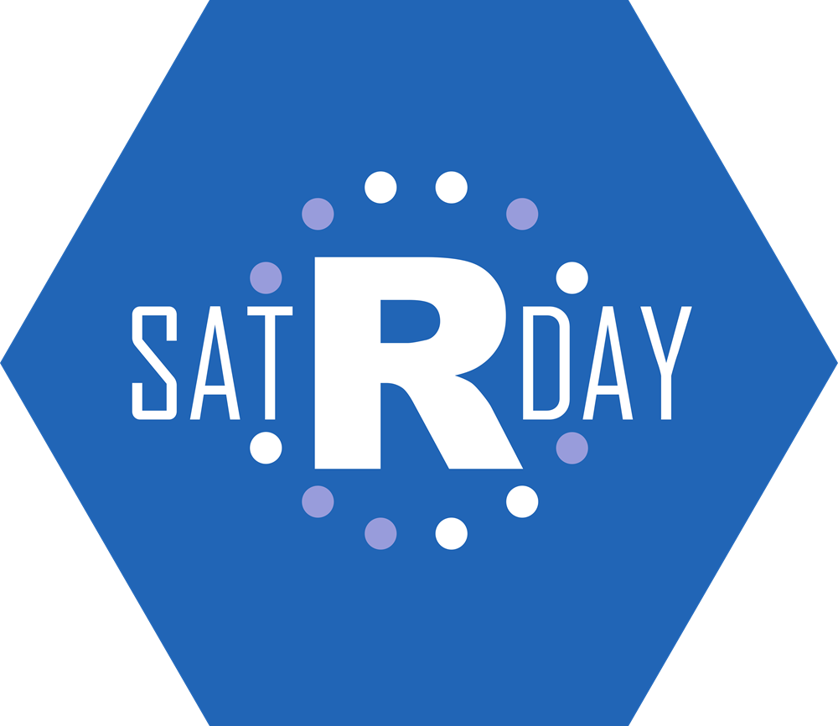





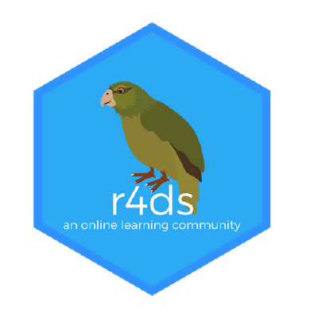





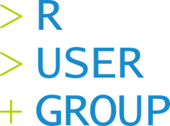
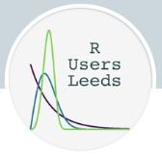



The Wider R Community

